Slide 1

AUTOMATION TEST
WITH
KATALON

Slide 2

OUR TEAM
Lâm Tâm Như
Phan Thiều Ngọc
Đặng Minh Tiến
Đào Hữu Đức
Nguyễn Ngọc Phượng
Mai Phước Sự

Slide 3
01
02
03
INTRODUCTION
TEST CASE
KATALON STUDIO
04
05
06
[WEBUI] TAKE SCREENSHOT
CI/CD
CONCLUSION
OUTLINE
Introduce about
Automation test and Katalon
Introduce about Web Application Testing
How to create and execute automated tests with Katalon Studio
Report with screenshot feature
Integrate in CI/CD
Summary about Automation test and Katalon

Slide 4




Katalon
01
02
What is Katalon?
Developed by
KMS Technology
Katalon is an automation testing software tool
03
04
Technologies
Supported technologies
Based on Selenium and Appium
Support for testing Web, API, Mobile, Desktop App.
Support for most OS now.

Slide 5
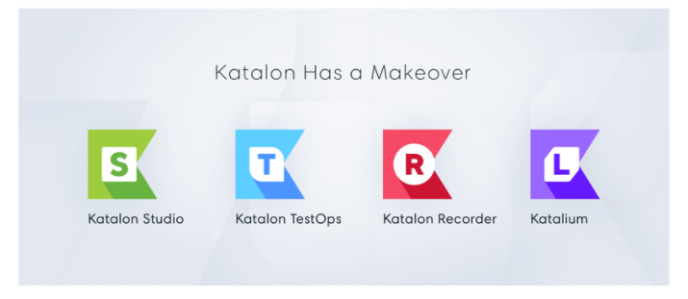
Relevant products

Slide 6

What are the features of Katalon?
Write test cases quickly and simply, support Manual and Scripting modes.
Support Codeless.
Support Data-Driven Testing.
Support run from the command line, CI/CD integration.
Built-in keywords available for Web, API, mobile, desktop application

Slide 7

http://fptbookstore.slimair.cool/
Web Application
for Testing
Scan here

Slide 8
Demo Katalon:
Screenshot

Slide 9
Why Test Automation in CI/CD
Presently we are in the age of DevOps, that integrates every step of the life-cycle of software development, bringing all the operations together, collaboratively, without any organizational silos.
Automation thrives on a CI/CD pipeline, which justifies the quick deliveries and feedback loops. However, test automation and continuous testing (CT) are critical to achieving truly effective CI/CD.
Although Continuous Integration and Continuous Delivery are essential for product releases to be accelerated, Continuous Testing is what brings in quality to these accelerated releases.

Slide 10
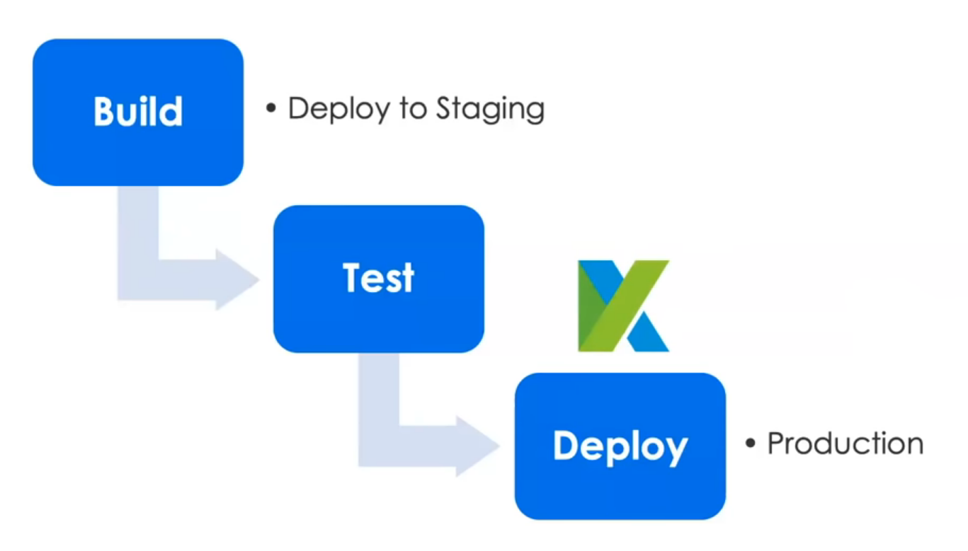
Katalon Role in CI/CD

Slide 11
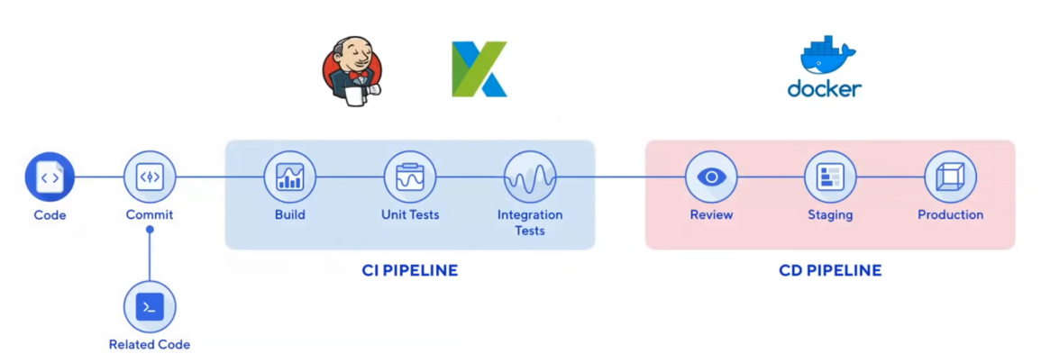
CI/CD Pipeline

Slide 12
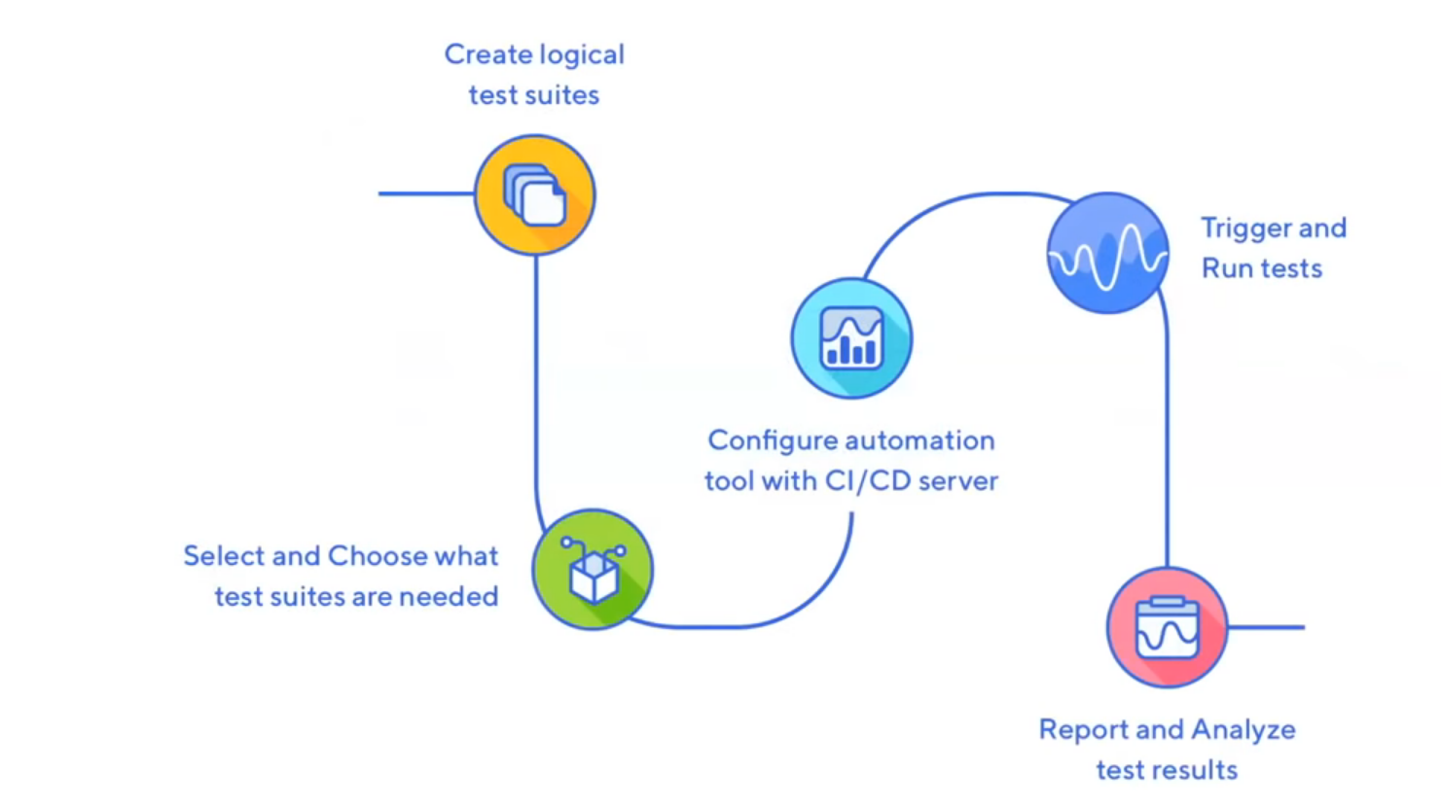

Automation Setup

Slide 13
Four Steps To Start:
1. Download & Start Jenkins https://www.jenkins.io/download/
2. Create a job in Jenkins
3. Add Katalon Studio Commands
4. Run & Test

Slide 14
Demo Integrate
in CI/CD

Slide 15

What is the outstanding of Katalon?

Slide 16
Advantages of Katalon
Ease of deployment
Wider set of integration
Dual scripting interfaces for users with different programming skills
Intuitive analytics dashboard and reports
Supports several types of testing
User-friendly GUI

Slide 17

Conclusion
Katalon TestOps
Katalon Recorder
Katalium
Katalon Studio
Take screenshot for automation testing & analytic report
Katalon is automation testing software tool
Integration:
CI / CD with Jenkins

Slide 18
THANKS FOR LISTENING
Q & A?

